Slide 1



PYTHON
Home
Service
About Us
Contact
Search . . . .
system
movie booking

Slide 2

PYTHON
Home
Service
About Us
Contact
Search . . . .
About
This movie booking system enables users to efficiently search, select, and reserve seats for their preferred movie screenings. By simplifying the booking procedure, it enhances the experience for cinema enthusiasts and theater management alike.

Slide 3
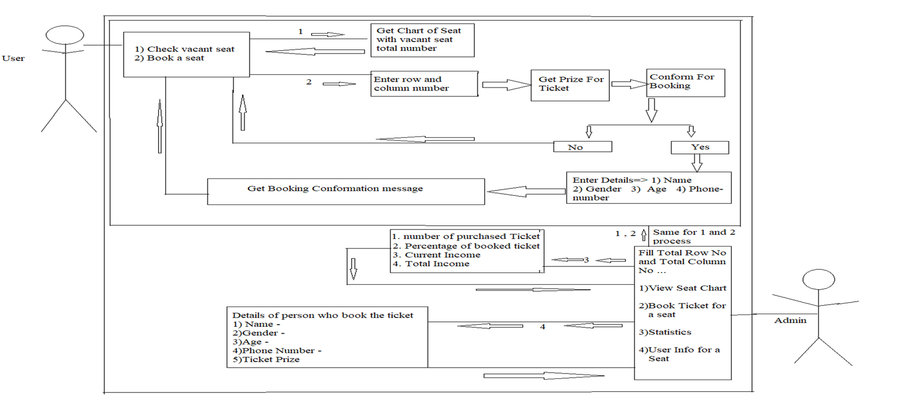
PYTHON
Home
Service
About Us
Contact
Search . . . .
USE-CASE DIAGRAM

Slide 4

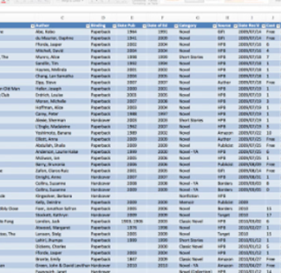

PYTHON
Home
Service
About Us
Contact
Search . . . .
Database Design and Implementation
USER DATA
SYSTEM STORES USER INFORMATION, INCLUDING THEIR PERSONAL DETAILS AND BOOKING HISTORY, TO PROVIDE A PERSONALIZED EXPERIENCE.
MOVIE LISTINGS
THE DATABASE HOLDS COMPREHENSIVE DATA ON AVAILABLE MOVIES, SHOWTIMES, AND SEATING INFORMATION TO ENABLE EFFICIENT BOOKING.
RESERVATION MANAGEMENT
THE SYSTEM TRACKS AND MANAGES SEAT RESERVATIONS, ENSURING REAL-TIME AVAILABILITY AND PREVENTING DOUBLE-BOOKINGS.

Slide 5
PYTHON
Home
Service
About Us
Contact
Search . . . .
User Login and AuthenticatioN
Secure Login:
Users can create an account with their personal information, which is securely stored in the database.
01
Multi-Factor Authentication:
The system employs robust authentication measures, such as passwords to protect user accounts.
02

Slide 6

PYTHON
Home
Service
About Us
Contact
Search . . . .
Movie Listing and Selection
Comprehensive Catalog
The system offers a wide selection of movies, allowing users to browse and filter by genre, rating, and showtimes.
Detailed Information
Users can access detailed movie descriptions, cast information, and reviews to help them make informed choices.
01
02
Seat Availability
The system displays real-time seat availability for each movie, enabling users to select their preferred seats.
Ticket Pricing
The system provides transparent pricing information, including any discounts or promotions, to ensure a seamless booking experience.
03
04

Slide 7
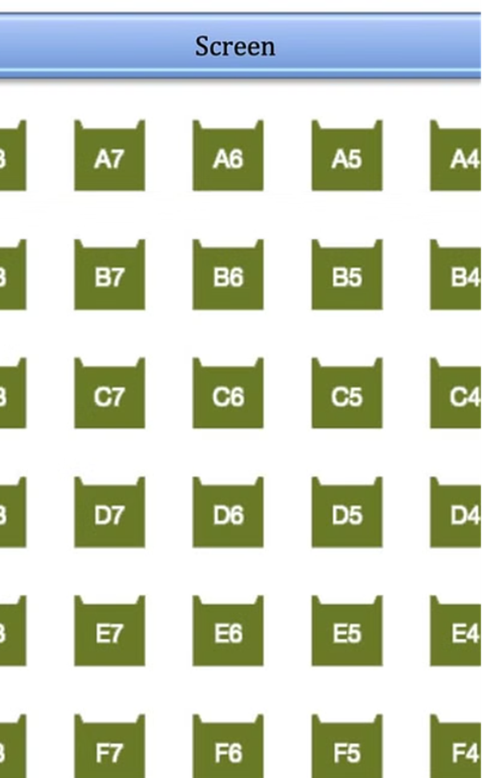
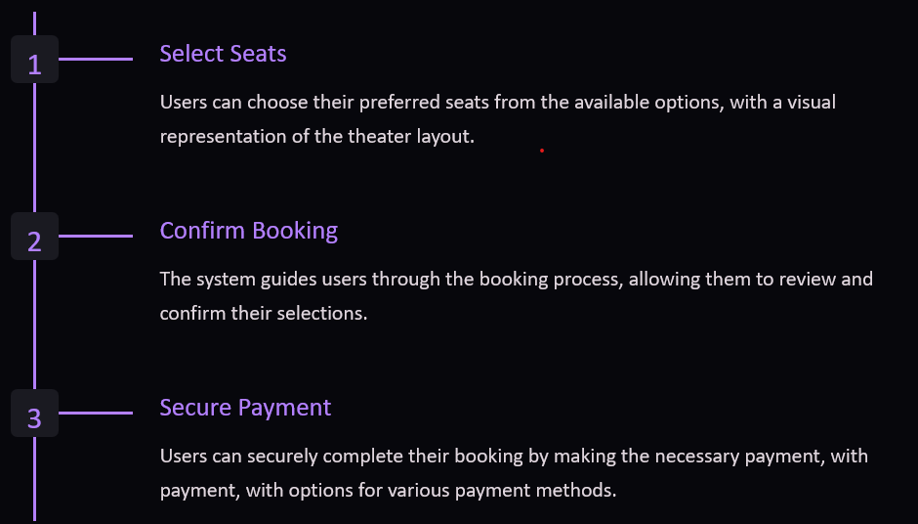
PYTHON
Home
Service
About Us
Contact
Search . . . .
Seat Booking and Reservation

Slide 8
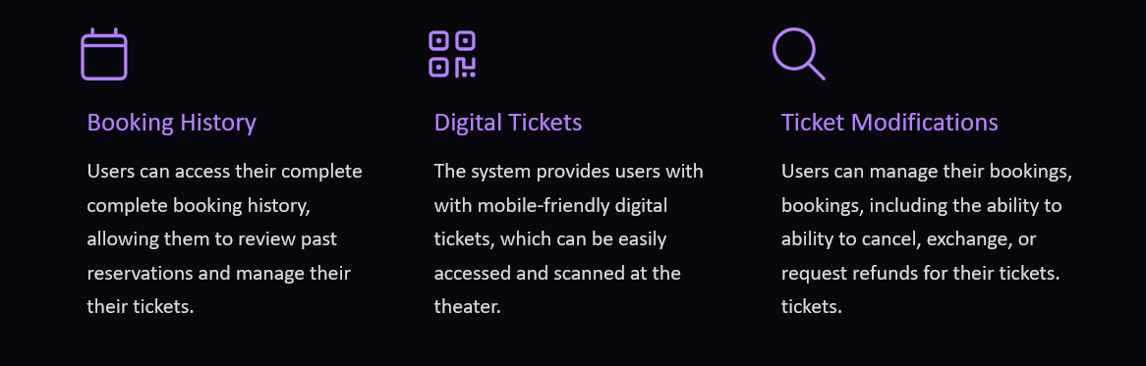
PYTHON
Home
Service
About Us
Contact
Search . . . .
Booking History and Ticket Management

Slide 9

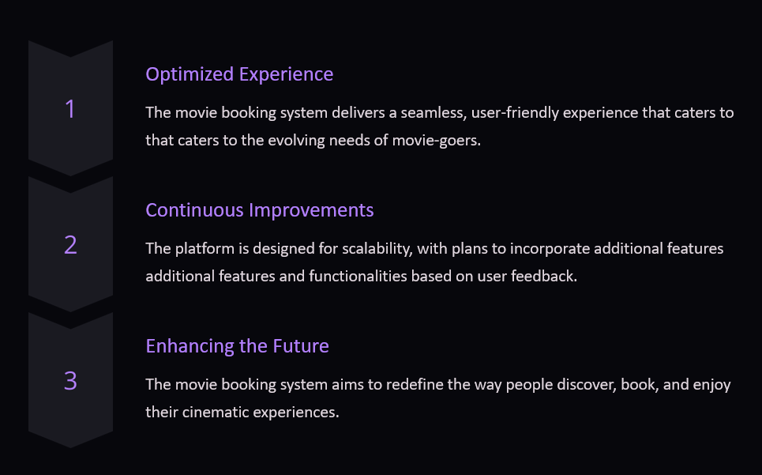
PYTHON
Home
Service
About Us
Contact
Search . . . .
Conclusion and Future Enhancements

Slide 10
PYTHON
Home
Service
About Us
Contact
Search . . . .
Thank You

